Slide 1

Big Data
Elasticsearch Practical

Slide 2


Slide 3
Content
Setup
Introduction
Basics
Search in Depth
Human Language
Aggregations

Slide 4
Setup
Go to https://github.com/tomvdbulck/elasticsearchworkshop
Make sure the following items have been installed on your machine:
Java 7 or higher
Git (if you like a pretty interface to deal with git, try SourceTree)
Maven
Install VirtualBox https://www.virtualbox.org/wiki/Downloads
Install Vagrant https://www.vagrantup.com/downloads.html
Clone the repository into your workspace
Open a command prompt, go to the elasticsearchworkshop folder and run vagrant up
This will start up the vagrant box. The first time will take a while (approx. 5 min) as it has to download the OS image, elasticsearch and other dependencies.

Slide 5
Introduction
Distributed restful search and analytics
Distributed
Built to scale horizontally
Based on Apache Lucene
High Availability (automatic failover and data replication)
Restful
RESTful api using JSON over HTTP
Full text search
Document Oriented and Schema free

Slide 6
Introduction
ElasticSearch => Relational DB
Index => Database
Type => Table
Document => Row
Field => Column
Mapping => Schema
Shard => Partition

Slide 7
Introduction
Index
Like a database in relational database
It has a mapping which defines multiple types
Logical namespace which maps to 1 or more primary shards
Type
Like a table, has list of fields which can be attributed to documents of that type
Document
JSON document
Like a row
Is stored in an index, has a type and an id.

Slide 8
Introduction
Field
A document contains a list of fields, key/value pairs
Each field has a field ‘type’ which indicates type of data
Mapping
Is like a schema definition
Each index has a mapping which defines each type within the index
Can be defined explicitly or generated automatically when a document is indexed.

Slide 9
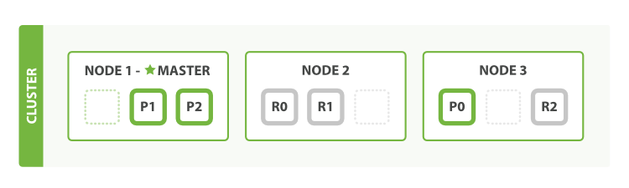
Introduction: Cluster, Nodes
Cluster
Consists of one or more nodes sharing the same cluster name.
Each cluster has 1 master node which is elected automatically
Node
Running instance of elasticsearch
@startup will automatically search for a cluster with the same cluster name

Slide 10
Introduction: Shards
Shard
Single Lucene instance
Low-level worker unit
Elasticsearch distributes shards among nodes automatically
Primary Shard
Each document is stored in a single primary shard
1st indexed on primary shard (by default 5 shards per index)
Then on all replicas of the primary shard (by default 1 replica per shard)
Replica Shard
Each primary can have 0 or more replicas
Has 2 functions
- high availability (failover) - can be promoted to primary
- increase performance - can handle get and search requests

Slide 11
Introduction: Filter vs Query
Although we refer to the query DSL there are 2 DSL’s, the filter DSL and the query DSL
Filter DSL
A filter ask a yes/no question of every document and is used for fields that contain exact values
Is the created date in the range 2013 - 2014? Does the status field contain the term published? Is the lat_lon field within 10km of a specified point?
Query DSL
Similar to a filter but also asks the question, “how well does this document match?”
Best matching the words full text search Containing the word run, but maybe also matching runs, running, jog, or sprint Containing the words quick, brown, and fox—the closer together they are, the more relevant the document

Slide 12
Introduction: Filter vs Query
Differences
Filter is quicker, as a query must calculate the relevance score
Goal of a filter is to reduce the amount of documents which need to be examined by a query
When to use: query for full text search or anytime you need a relevance score.
Filters for everything else.

Slide 13
Basics
Connection to ElasticSearch
Inserting data
Searching data
Updating data
Deleting Data
Parent - Child

Slide 14
Basics: Connecting to Elasticsearch
Node Client and Transport Client
Node Client: acts as a node which joins the cluster (same as the data nodes) - all nodes are aware of each other
Better query performance
Bigger memory footprint and slower start up
Less secure (application tied to the cluster)
Transport client: connects every time to the cluster
No lucene dependencies in your project (unless you use spring boot ;-)
Starts up faster
Application decoupled from the cluster
Less efficient to access index and execute queries
Notes:
Transport client vs node client - http://www.elasticsearch.org/guide/en/elasticsearch/guide/current/_transport_client_versus_node_client.html

Slide 15

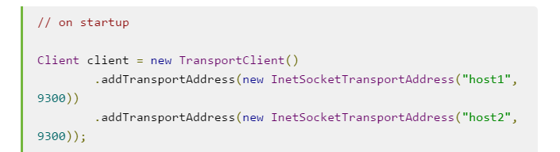
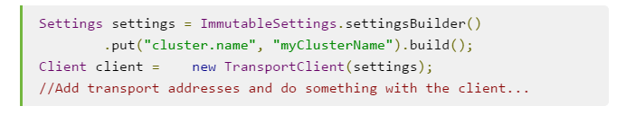
Basics: Connecting to Elasticsearch
Node Client (if we would use this - we would all form 1 big cluster)
Transport Client (we use this one in the exercises)

Slide 16
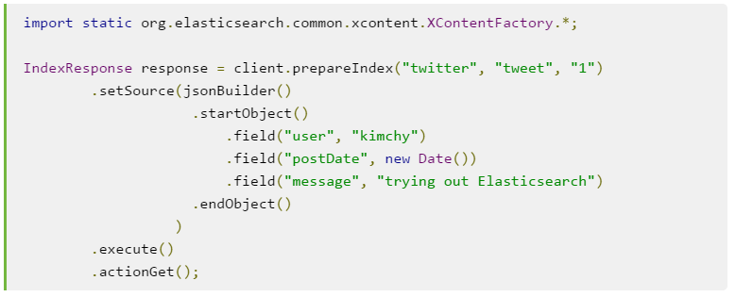
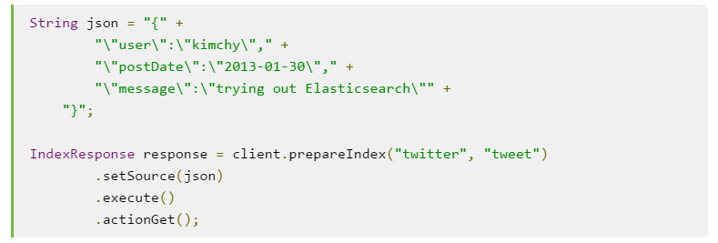
Basics: Inserting Data

Slide 17

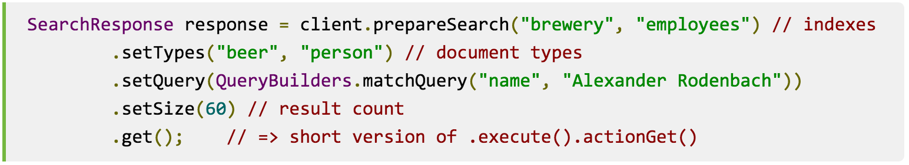
Basics: Searching Data
Get API
Retrieve document based on its id
Search API
Returns a single page of results

Slide 18
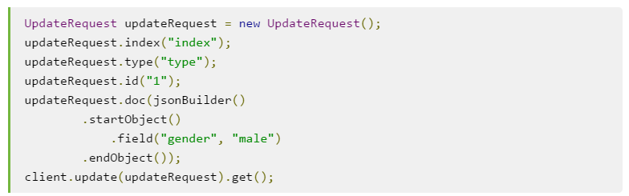
Basics: Updating Data

Slide 19
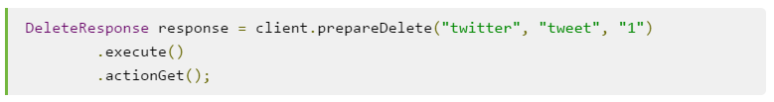
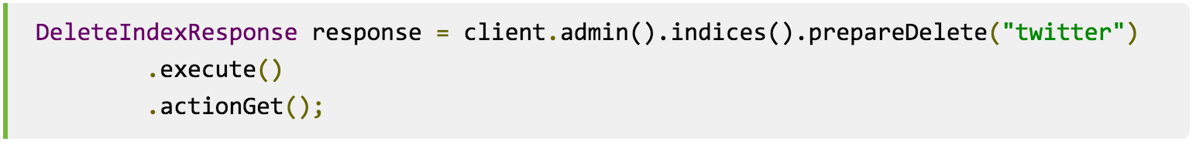
Basics: Deleting Data
Delete a document
Delete an index
For performing operations on index, use admin client => client.admin()

Slide 20
Basics: Exercises
Time for Exercises
Begin with exercises in package: be.ordina.wes.exercises.basics
Some hints
Go to http://localhost:9200/_plugin/marvel
Choose “sense” in the upper right corner under “Dashboards”
Sense:
You can see how an index has been created
You can analyze -> what will the index do with your search query

Slide 21
Search in Depth
Filters
very important as they are very fast
do not calculate relevance
are easily cached
Multi-Field Search

Slide 22
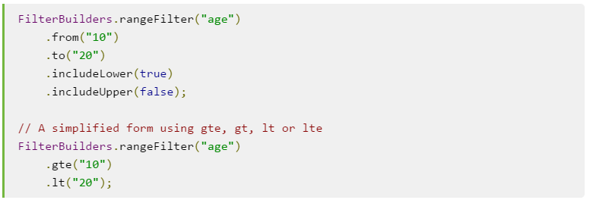
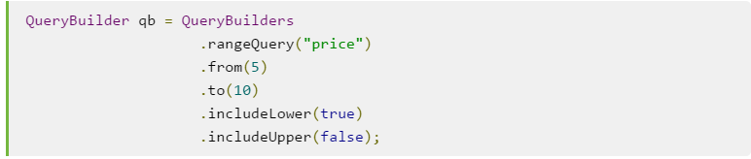
Search in Depth: Filters
Range Filter
you also have queries, please note that a query is slower than a filter

Slide 23
Search in Depth: Filters
Term Filter
Filters on a term (not analyzed)
so you must pass the exact term as it exists in the index
no automatic conversion of lower - and uppercase
The result is automatically cached
Some filters are automatically cached, if so, this can be overridden

Slide 24
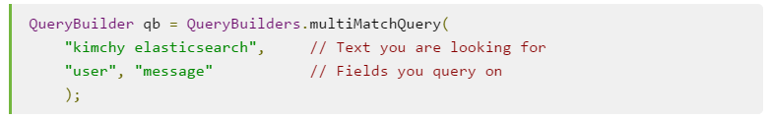
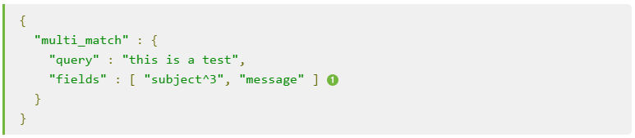
Search in Depth: Multi-Field Search
fields can be boosted
in the example below subject field is boosted by a factor of 3

Slide 25
Search in Depth: Exercises
Time for Exercises
Begin with exercises in package: be.ordina.wes.exercises.advanced_search

Slide 26
Human Language
Use default Analyzers
Inserting stop words
Synonyms
Normalizing

Slide 27
Human Language: Default Analyzers
Ships with a collection of analyzers for most common languages
Have 4 functions
Tokenize text in individual words
The quick brown foxes → [The, quick, brown, foxes]
Lowercase tokens
The → the
Remove common stopwords
[The, quick, brown, foxes] → [quick, brown, foxes]
Stem tokens to their root form
foxes → fox

Slide 28
Human Language: Default Analyzers
Can also apply transformations specific to a language to make words more searchable
The english analyzer removes the possessive ‘s
John's → john
The french analyzer removes elisions and diacritics
l'église → eglis
The german analyzer normalizers terms
äußerst → ausserst

Slide 29
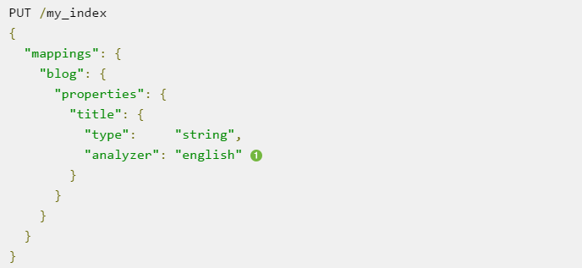
Human Language: Default Analyzers

Slide 30
Human Language: Inserting Stop Words
Words which are common to a language but add little to no value for a search
default english stopwords
a, an, and, are, as, at, be, but, by, for, if, in, into, is, it, no, not, of, on, or, such, that, the, their, then, there, these, they, this, to, was, will, with
Pros
Performance (disk space is no longer an argument)
Cons
Reduce our ability to perform certain searches
distinguish happy from ‘not happy’
search for the band ‘The The’
finding Shakespeare’s quotation ‘To be, or not to be’
Using the country code for Norway ‘No’

Slide 31
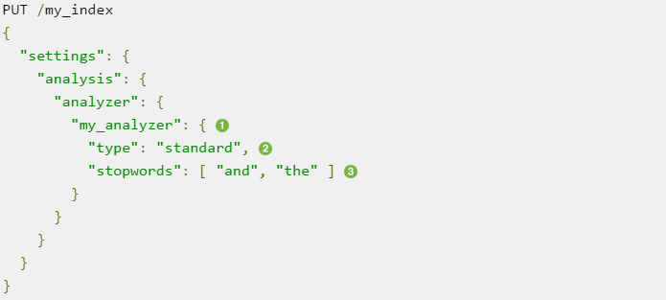
Human Language: Inserting Stop Words
default stopwords can be used via the _lang_ annotation

Slide 32
Human Language: Synonyms
Broaden the scope, not narrow it
No document matches “English queen”, but documents containing “British monarch” would still be considered a good match
Using the synonym token filter at both index and search time is redundant.
At index time a word is replaced by the synonyms
At search time a query would be converted from “English” to “english” or “british”

Slide 33
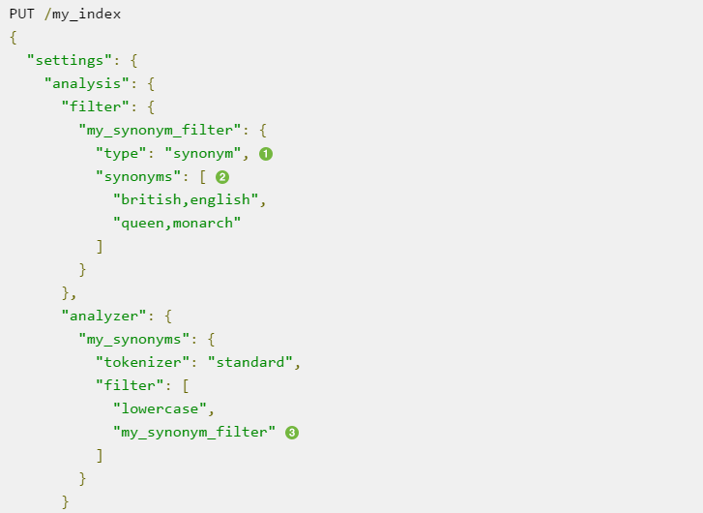
Human Language: Synonyms

Slide 34
Human Language: Normalizing
Removes ‘insignificant’ differences between otherwise identical words
uppercase vs lowercase
é to e
Default filters
lowercase
asciifolding
remove diacritics (like ^)

Slide 35
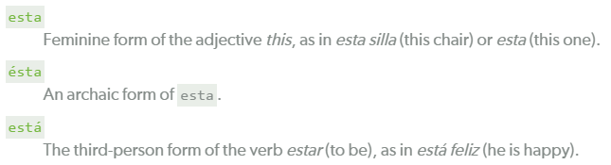
Human Language: Normalizing
Retaining meaning
When you normalize, you lose meaning (spanish example)
For that reason it is best to index twice
1 time - normalized
1 time the original form
(this is also a good practice and will generate better results with a multi-match query)

Slide 36
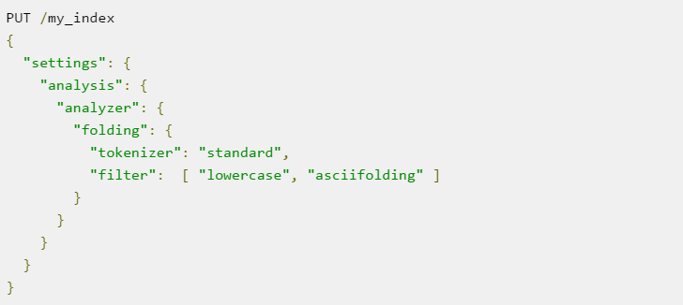
Human Language: Normalizing
For the exercises not important - but pay attention to the sequence of the filters as they are applied sequentially.

Slide 37
Languages: Exercises
Time for Exercises
Begin with exercises in package: be.ordina.wes.exercises.language

Slide 38
Aggregations
Not like search - now we zoom out to get an overview of the data
Allows use to ask sophisticated questions of our data
Uses the same data structures => almost as fast as search
Operates alongside search - so you can do both search and analyze simultaneously

Slide 39
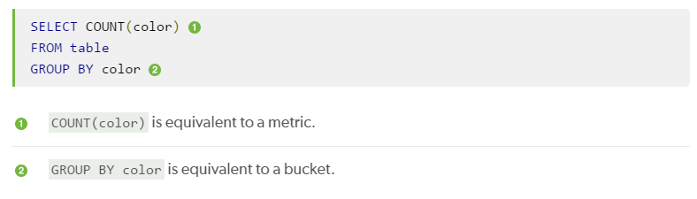
Aggregations
Buckets
collection of documents matching criteria
can be nested
Metrics
statistics calculated on the documents in a bucket
translation in rough sql terms:

Slide 40
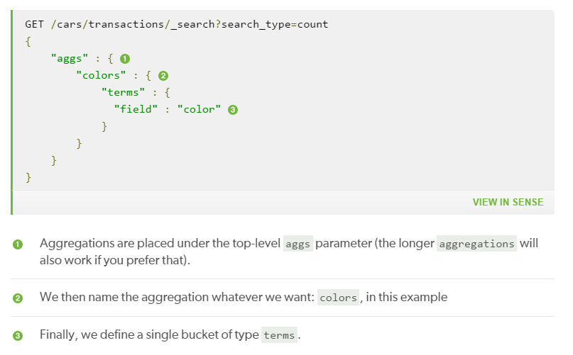
Aggregations

Slide 41
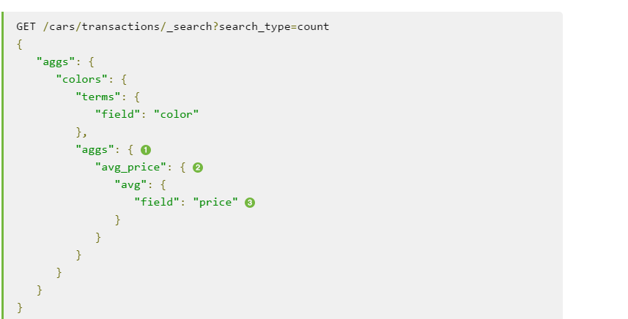
Aggregations
We add a new aggs level to hold the metric. We then give the metric a name: avg_price. And finally, we define it as an avg metric over the price field.

Slide 42
Aggregations: Exercises
Time for Exercises
Begin with exercises in package: be.ordina.wes.exercises.aggregations

Slide 43


Questions or Suggestions?
Notes:
Elasticsearch meetup group - http://www.meetup.com/ElasticSearch-User-Group-Belux-Belgium-Luxembourg/

